Slide 1


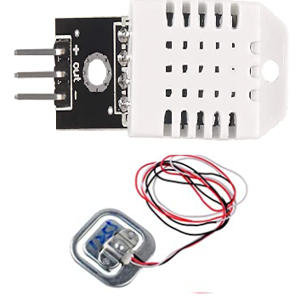
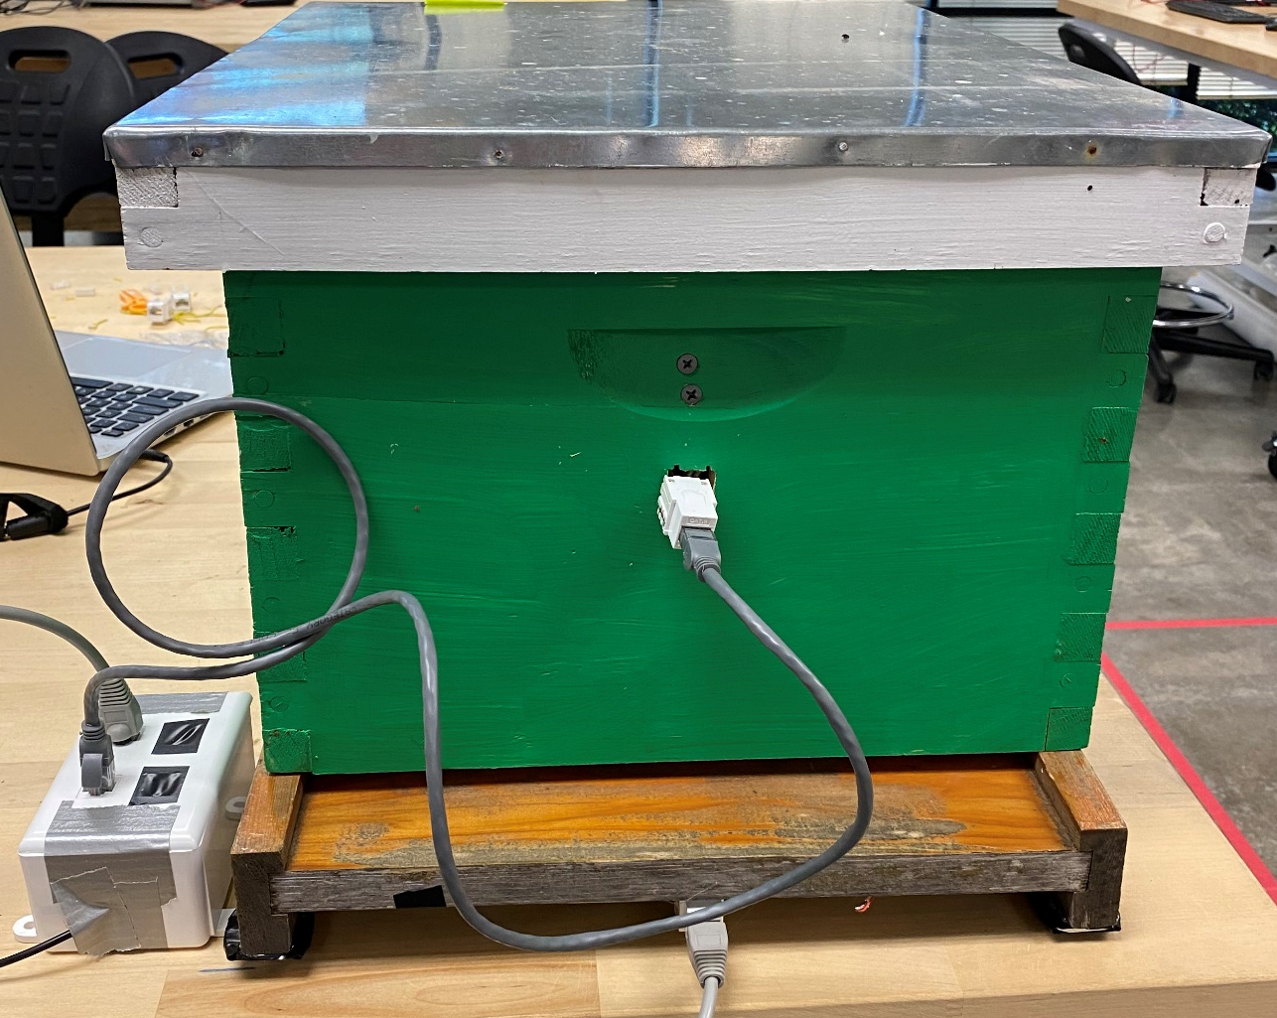

Beehive Monitoring System
UT Dallas Office of Sustainability
Lisa Chen, Computer Science Ruben Thomas, Computer Science
Sohila Elfar, Biomedical Engineering Ava Romberg, Computer Science
Shuhrat Choudhury, Computer Engineering Guaidi Morado, Computer Science
Fall 2021
Partner Description
UT Dallas has on-campus apiaries with 12 to 20 hives that produce up to 300 lbs. of honey annually.
Mission: The UTD Office of Sustainability works with students, faculty, administration and other stakeholders to encourage sustainability.
Semester Accomplishments
This semester, our team has:
Worked to refine previous team’s prototype
Deduced an optimal propolis-free location for the sensors to avoid:
Dishevelment by the removal of hive frames
Prototyped wire weather-proofing and organization setup
Researched solar power energy source options to power system and installed chosen solar panels
Tested code to display sensors data on our website
Project Description
Build a solar powered beehive monitoring system that can remotely collect and track the hive’s:
Temperature
Humidity
Weight
Readings from installed sensors are uploaded to the website and display in a graph for viewing and monitoring.
Impact
Reduces beekeeper’s labor
Makes monitoring the hive, bee’s health, and honey production:
Easier
Efficient
Economic
Hassle free
Stress free for the bee’s environment
Encourages bee-keeping in the community
Raising environmental awareness
Next Steps
Polish hive design
Finesse wiring setup
Further field testing
Publish website
Finalize hive prototype
Create user manual

